Slide 1
Big Data Hackathon
Cancer Analysis for San Diegans
White Walkers
Notes:
Introduction: About cloud

Slide 2
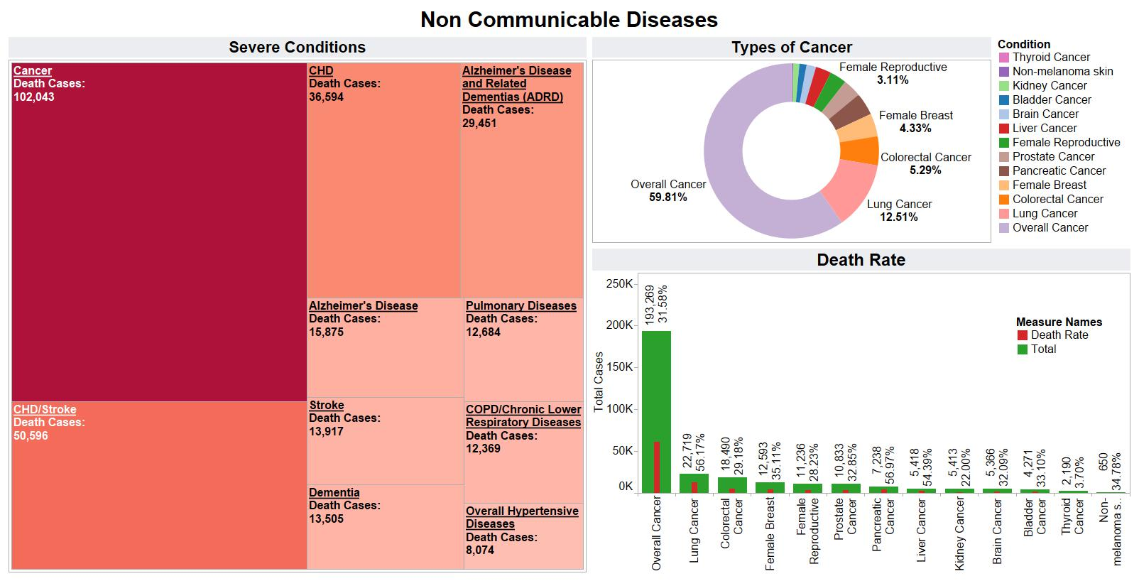
Non-Communicable Diseases

Slide 3
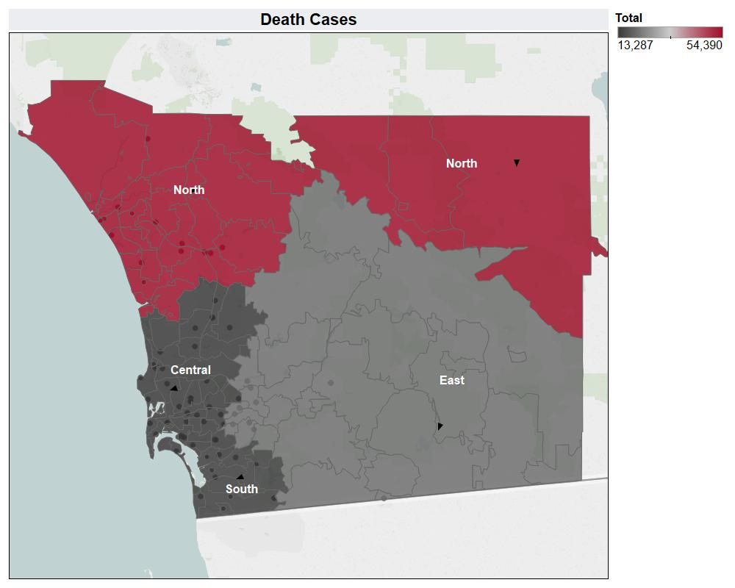
Death Cases by Region

Slide 4
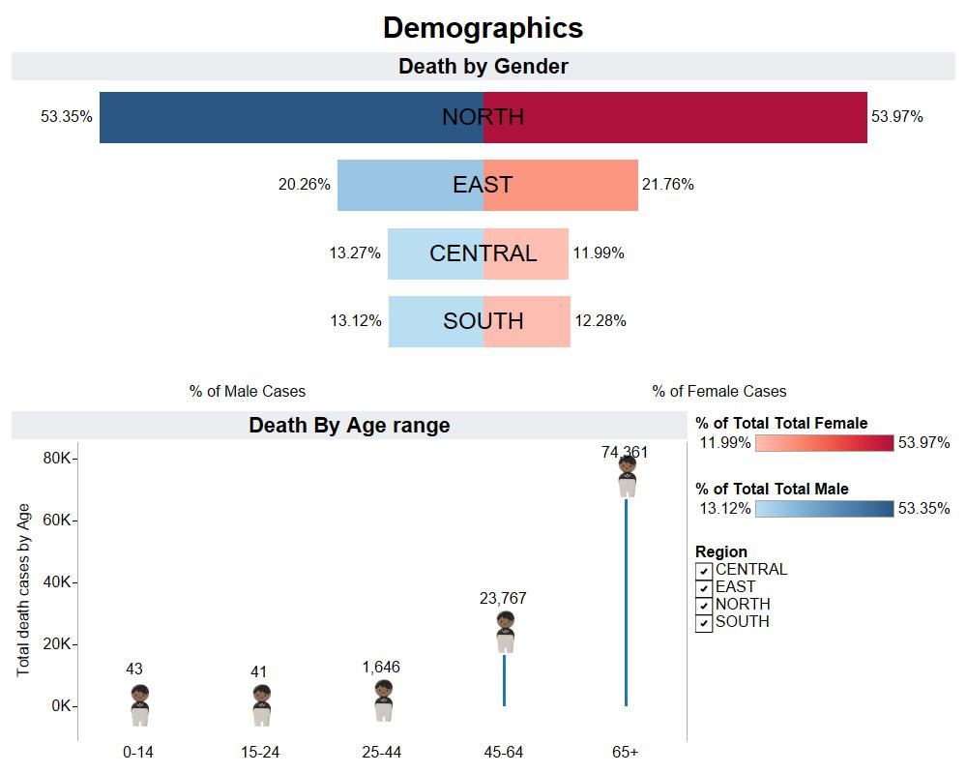
Demographics

Slide 5
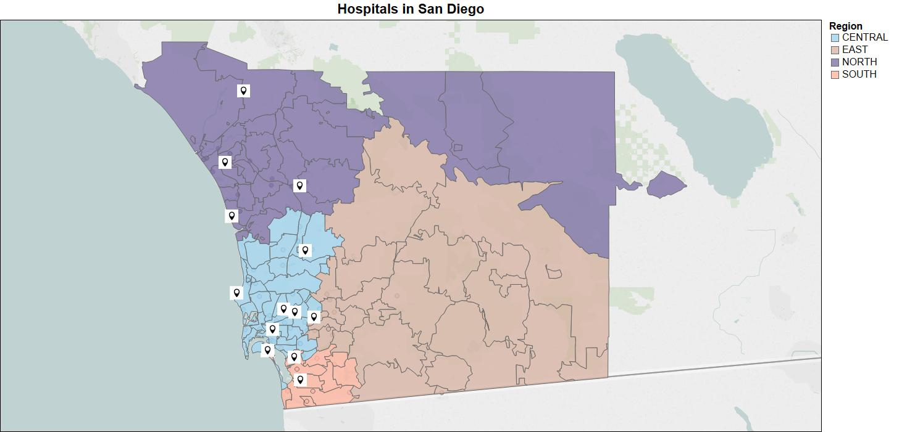
Nearest Hospital location

Slide 6
Recommendation

Slide 7
Tools and Source

Slide 8
Team Members
Kunal Lalwani
Rashmi Sawant
Shraddha Masuti
Adil Rahman
Deepika Siriah
Ketul Patel

Slide 9
Q&A
Notes:
Results are % accuracy
Important factors
Our model helps to understand the variables that affects the H1B case status, this would reduce the risk of choosing the wrong candidate.
Save investment on sponsoring the wrong candidate

